Slide 1

20EC5203 ELECTRONIC DESIGN PROJECT- I MODULE 1 - TEMPERATURE CONTROLLED FAN. MODULE 2 - DC TO DC COVERTER
Presented by:
NARMATHA V (811722106063)﻿
NIKHITHA Ra (811722106066)
SREERAM S P (811722106107)
Under the Guidance of
Ms.Geerthana
Assistant professor
Department of ECE

Slide 2
OUTLINE
ABSTRACT –MODULE 1
INTRODUCTION
LITERATURE SURVEY
BLOCK DIAGRAM
CIRCUIT DIAGRAM
HARDWARE MODULE
ADVANTAGES AND APPLICATIONS
ABSTRACT –MODULE 2
INTRODUCTION
LITERATURE SURVEY
BLOCK DIAGRAM
CIRCUIT DIAGRAM
HARDWARE MODULE
ADVANTAGES AND APPLICATIONS
CONCLUSION
REFERENCES

Slide 3
MODULE 1 - TEMPERATURE CONTROLLED FAN

Slide 4
ABSTRACT
This project aims to develop a temperature-controlled fan system that automatically adjusts its speed in response to changes in room temperature, ensuring optimal airflow, enhanced comfort, and improved energy efficiency. Traditional fans operate at fixed speeds, leading to unnecessary energy consumption and an inability to maintain ideal indoor conditions. Existing solutions, such as thermostatic switches and smart controllers, partially address these issues but often exhibit limitations such as delayed response times, inconsistent performance, and limited compatibility with different fan models.To overcome these challenges, the proposed system integrates modern technologies, including temperature sensors, microcontrollers, and efficient motor control mechanisms. These components work together to provide real-time adjustments, precise control, and seamless operation across various fan types. By dynamically varying airflow to match the surrounding temperature, the system reduces energy waste, prevents overheating, and creates a more comfortable and sustainable indoor environment.

Slide 5
INTRODUCTION – MODULE 1
A temperature-controlled fan is an innovative solution designed to enhance indoor comfort and energy efficiency by automatically adjusting its speed based on room temperature. Unlike traditional fans, this system ensures optimal airflow while minimizing energy waste, promoting sustainability and user convenience. Current solutions, such as thermostatic switches and smart controllers, face limitations like delayed response, inconsistent performance, and compatibility issues. This project aims to develop an advanced temperature-controlled fan using modern technologies, offering precise, real-time adjustments and improved reliability, making it a valuable addition to energy-efficient systems. This project focuses on the design and implementation of an intelligent temperature-controlled fan system that bridges the gap between energy efficiency and comfort. By leveraging cutting-edge technologies such as microcontrollers, temperature sensors, and efficient motor control mechanisms, the proposed system aims to deliver a next-generation solution that redefines indoor climate management.

Slide 6
OBJECTIVE & SCOPE :
OBJECTIVE:
Enhance indoor comfort by maintaining optimal airflow and temperature.
Minimize energy consumption by dynamically regulating fan speed according to environmental conditions.
Overcome limitations of existing solutions, such as delayed response and compatibility issues.
Contribute to sustainable practices by reducing unnecessary power usage.
SCOPE :
SYSTEM DESIGN: Developing a hardware and software solution integrating temperature sensors, microcontrollers, and motor control units.
ENERGY EFFICIENCY: Ensuring low power consumption through intelligent speed adjustments and optimizing the system for minimal energy waste.
REAL-TIME PERFORMANCE: Implementing real-time temperature sensing and fan speed adjustments for consistent and reliable performance.

Slide 7
LITERATURE SURVEY
Ref. No | Title & Author | Methodology or components used | Pros | Cons
1 | Room temperature based fan speed control system using pulse width modulation technique -F. T. Ahmed, A. A. K. Zazali, N. B. M. Salleh, et al. | PWM Fan Speed Control: Uses temperature sensors and a microcontroller to adjust fan speed via PWM based on ambient temperature. | Efficient and precise fan speed control. | Moderate complexity may require some technical expertise for implementation.
2 | Optimal Fan Speed Control for Thermal Management of Servers - M. R. P. J. Mendes, M. T. Silva, J. M. P. Almeida | Optimal Fan Speed Control for Servers: Employs real-time temperature feedback and dynamic optimization algorithms to adjust fan speeds for efficient thermal management in servers. | Highly effective in preventing overheating in server environments. | High complexity can increase implementation costs and require specialized knowledge.
3 | Automatic Ceiling Fan Control Using Temperature and Room Occupancy- M. R. F. Yusof, N. A. M. Zain, M. N. A. F. Nazri | Automatic Ceiling Fan Control: Combines temperature and occupancy sensors to automatically adjust fan speed, optimizing energy use based on room occupancy. | Enhances energy savings by considering occupancy. | Requires reliable occupancy detection technology, which may not always be accurate.
4 | Temperature Based Fan Speed Controller- P. J. Dey, K. B. Ghosh, S. D. Choudhury | Temperature Based Fan Speed Controller: Utilizes basic temperature sensors and a simple threshold-based control system to operate the fan at different speeds based on set temperature levels. | Cost-effective solution for basic temperature control. | Limited functionality without advanced control features; not suitable for complex environments.
5 | Smart Fan Control System Using IoT and Machine Learning for Energy Efficiency-M. R. Hasan, M. S. Al Azad, and M. A. H. Chowdhury. | Smart Fan Control with IoT: Uses IoT sensors and machine learning to gather data and predict optimal fan speeds, allowing remote control via a mobile app. | Highly adaptable and efficient through predictive algorithms. | Potential privacy and security concerns related to IoT devices.

Slide 8
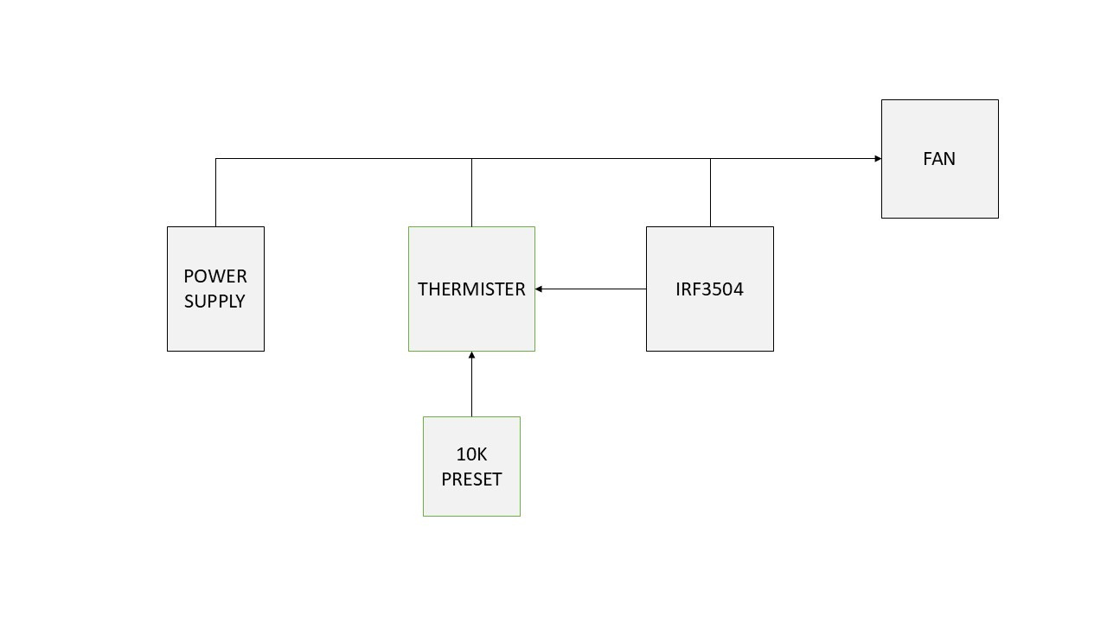
BLOCK DIAGRAM

Slide 9
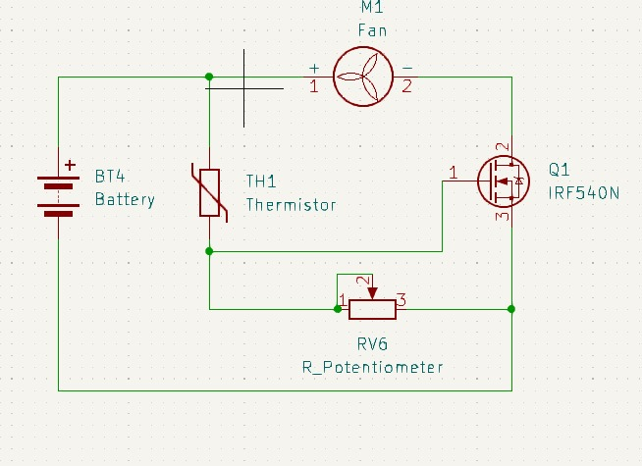
CIRCUIT DIAGRAM

Slide 10
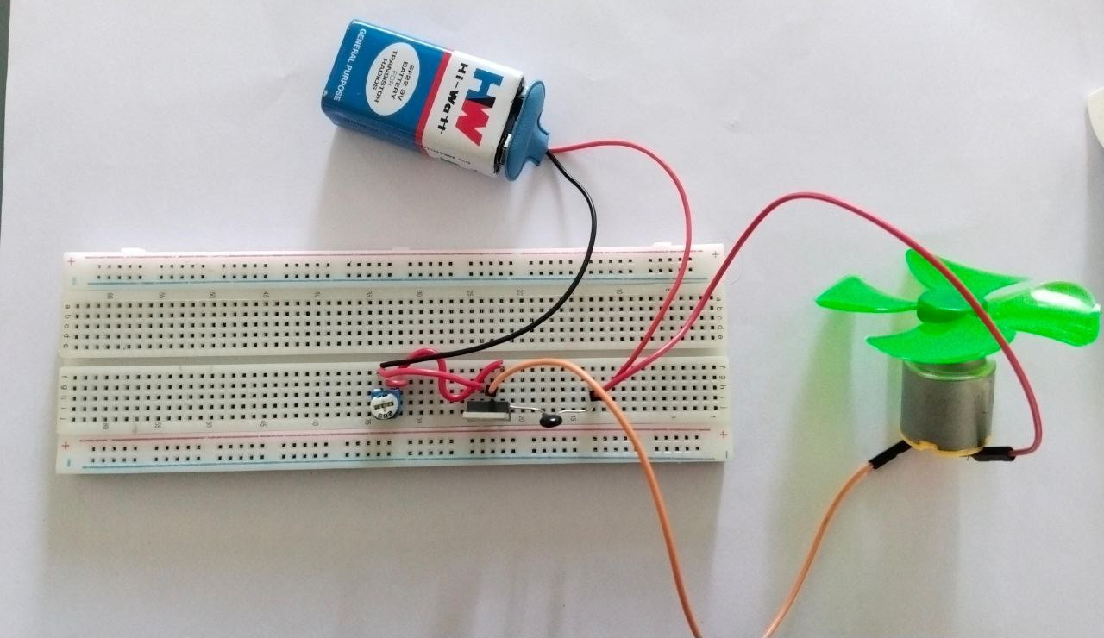
HARDWARE MODULE

Slide 11
ADVANTAGES AND APPLICATIONS
Energy efficiency:
It automatically adjusts its speed based on the room temperature, which can help reduce energy consumption compared to a fan running at a constant speed.
Enhanced comfort:
By maintaining a consistent temperature, it helps keep indoor conditions comfortable and prevents overheating.
Extended fan life:
Running at variable speeds reduces wear and tear on the fan, potentially extending its lifespan.
APPLICATION:
Home cooling
Server rooms

Slide 12
MODULE 2 –TOUCH ON-OFF SENSOR SWITCH

Slide 13
ABSTRACT - MODULE 2
Traditional mechanical switches used in household and industrial applications are prone to wear and tear, leading to reduced durability, unreliable performance, and frequent maintenance requirements. To address these limitations, touch on-off sensor switches provide a modern, contactless alternative that enhances durability, ensures consistent performance, and offers an intuitive user experience. These switches are particularly suited for smart environments, where seamless control and automation are prioritized. This project aims to design and develop a robust touch on-off sensor switch system that leverages advanced sensing technologies and adaptive algorithms to overcome these challenges. The proposed solution focuses on improving accuracy, adaptability, and resilience against environmental interference. By addressing these issues, the project seeks to modernize control systems, improve device longevity, and facilitate reliable and user-friendly interaction across a wide range of household, commercial, and industrial settings.

Slide 14
INTRODUCTION – MODULE 2
Touch on-off sensor switches represent a significant advancement in control systems by offering a seamless, contactless, and intuitive user experience. Unlike traditional mechanical switches, these sensor-based systems are designed to enhance durability and device longevity while requiring minimal maintenance. The adoption of touch-based controls is particularly transformative in smart environments, where automation and intuitive control interfaces play a central role in improving functionality and user satisfaction. This project aims to design and develop a robust touch on-off sensor switch system that overcomes these limitations. By employing advanced sensing technologies and adaptive algorithms, the proposed solution ensures consistent performance, high accuracy, and resilience against environmental interference. This innovation not only modernizes control systems but also aligns with the vision of creating smarter, more reliable, and user-friendly devices for a wide range of applications.

Slide 15
OBJECTIVE & SCOPE :
OBJECTIVE:
Eliminate issues related to wear and tear in mechanical switches by offering a contactless interface.
Enhance accuracy and prevent false triggering caused by environmental factors such as dust, moisture, or accidental touches.
Ensure compatibility with diverse materials, including gloves, for versatile applications.
SCOPE :
COMPATIBILITY: Ensuring the system is adaptable to various materials, including gloves, and applicable in household, commercial, and industrial settings.
ENERGY EFFICIENCY: Incorporating low-power consumption features to align with sustainable practices.
USER EXPERIENCE: Creating an intuitive and seamless touch interface that integrates easily into modern smart environments.

Slide 16
LITERATURE SURVEY
Ref. No | Title & Author | Methodology or components used | Pros | Cons
1 | A touch controller using differential sensing method for on-cell capacitive touch screen panel systems Ik-Seok Yang,Oh-kyong Kwon | It improve the dynamic range of sensing voltage and reduce display noise. The system uses mutual capacitance sensing in on-cell capacitive touchscreens and integrates a readout circuit for accurate signal detection.. | High noise immunity,Improved signal-to-noise ratio,Low power consumption,Compact silicon footprint | Limited scalability to larger displaysDependency on precise manufacturing processes.
2 | Proposal of Triggered Touch Switch Model with High Accuracy Mingyu Fan , Daisuke Tanaka , Seiichi Serikawa | This paper proposes a triggered touch switch model emphasizing high accuracy through refined sensing algorithms and noise filtering. The system achieves precision by integrating high-resolution capacitive sensing. | Enhanced accuracy , Noise resilience ,precise touch input | Potential increase in response time due to noise filteringHigher cost
3 | Proposal of the Improved Touch Panel Switch Having High Flexibility Hiroshi Kawano, Seiichi Serikawa | This research introduces a flexible touch panel design using innovative materials and structures to ensure durability and adaptability. The focus is on improving user interface flexibility without compromising sensitivity. | High flexibility, Adaptability,consistent | Decreased sensitivity, Potential challenges

Slide 17
LITERATURE SURVEY
Ref. No | Title & Author | Methodology or components used | Pros | Cons
4 | A Flexible Touch Switch with Arbitrary Shape and Arrangement Shun Inoue, Akira Yamawaki, Seiichi Serikawa | The touch switch uses a thin, flexible conductive sheet as the electrode, allowing for arbitrary shapes and arrangements. | customized in shape, Lightweight and flexible. | Limited durability, Potential for signal noise
5 | Capacitive touch sensor Samuel Zuk, Alena Pietrikova, Igor Vehec | This sensor employs capacitive sensing to detect touch. It uses conductive electrodes for detections | High sensitivity, detect proximity, Low power consumption. | Sensitive to humidity, Limited performance

Slide 18
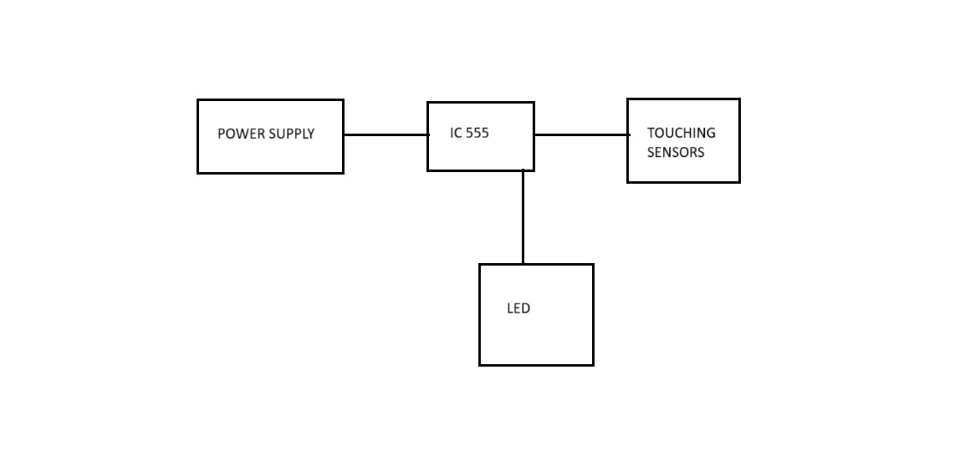
BLOCK DIAGRAM

Slide 19
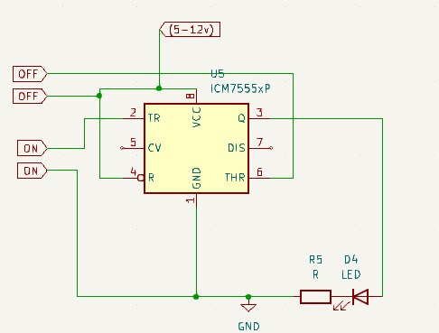
CIRCUIT DIAGRAM

Slide 20
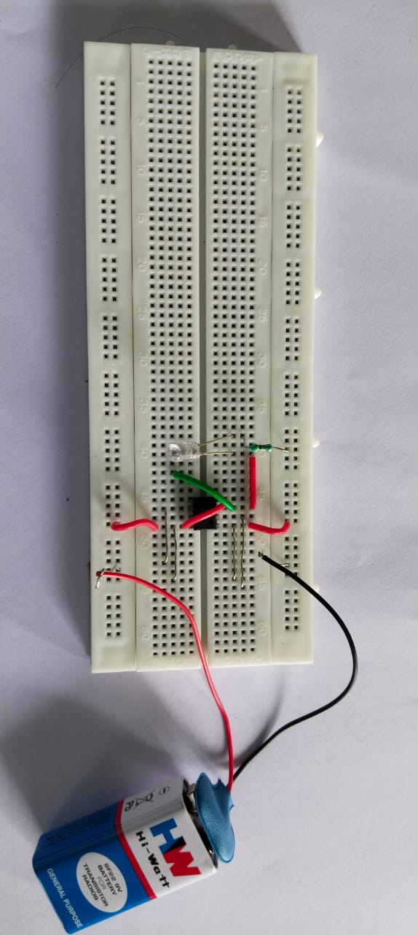
HARDWARE MODULE
https://drive.google.com/file/d/1aiDvwN541ds63CQ0SYLq23gn5uIJktdm/view?usp=drive_link

Slide 21
ADVANTAGES AND APPLICATIONS
ADVANTAGES:
DURABILITY AND LONGEVITY: Unlike mechanical switches, touch sensor switches have no moving parts, which reduces wear and tear and increases the lifespan of the device.
HYGIENE AND SAFETY: Contactless operation minimizes the risk of transferring germs and contaminants, making it ideal for environments requiring high hygiene standards.
ENERGY EFFICIENCY: Touch sensors can be designed to consume low power and activate devices only when needed, reducing energy waste.
VERSATILITY: Can be integrated into a variety of systems, from household appliances to industrial machinery, offering enhanced control options.

Slide 22
ADVANTAGES AND APPLICATIONS
APPLICATIONS:
SMART HOMES: Used to control lighting, fans, and other home appliances, contributing to a more intuitive and modern home automation system.
PUBLIC SPACES: Applied in public restrooms, elevators, and doors to improve hygiene and reduce the spread of germs.
INDUSTRIAL EQUIPMENT: Used for machinery and control panels in factories, where ease of operation and long-term durability are important.
CONSUMER ELECTRONICS: Integrated into devices such as touch lamps, smart TVs, and kitchen appliances for convenient user interaction.

Slide 23
CONCLUSION
The Temperature-Controlled Fan utilizes simple components like a thermistor, operational amplifier, and MOSFET to dynamically adjust fan speed based on ambient temperature. This system eliminates inefficiencies of manual control, optimizes energy usage, and promotes environmental sustainability while introducing automation concepts and sensor integration into circuit design.
The Touch On-Off Sensor Switch, leveraging a 555 Timer IC, showcases how touch-based controls can be implemented ergonomically and noninvasively. Its user-friendly design makes it applicable across a range of use cases, from home automation to prototyping, emphasizing durability and convenience. Both projects highlight the seamless integration of electronics and design to solve real-world problems while paving the way for more advanced and intelligent systems across various domains.

Slide 24
REFERENCES
1.Bhatia, V., & Bhatia, G. (2013). "Room temperature-based fan speed control system using pulse width modulation technique." International Journal of Computer Applications, vol.81, no.5, pp.35–38.
2.Wang, Z., Bash, C., Tolia, N., Marwah, M., Zhu, X., & Ranganathan, P. (2009). "Optimal fan speed control for thermal management of servers." Proceedings of the ASME/Pacific Rim Technical Conference and Exhibition on Packaging and Integration of Electronic and Photonic Systems, MEMS, and NEMS (InterPACK ’09), pp.1–9.
3.Kommey, B., Dunyo, J. K., Akowuah, B. Y., & Tamakloe, E. (2022). "Automatic ceiling fan control using temperature and room occupancy." Journal of Information Technology and Computer Engineering (JITCE), vol. 6, no. 1, pp. 1–7.
4.Srinivas, P., Kavinkumar, B., Arun Venkat, A., & Senthil Kumar, R. (2020). "Temperature-based fan speed controller." International Research Journal on Advanced Science Hub (IRJASH), vol. 2, no. 7, pp. 159–164.
5.Ahn, J., & Cho, S. (2017). "Dead-band vs. machine-learning control systems: Analysis of control benefits and energy efficiency." Journal of Building Engineering, 12, 17–25.

Slide 25
6.Khan, H. R., Ahmed, W., Masud, W., Alam, U., Arshad, K., Assaleh, K., & Qazi, S. A. (2024). "Design and experimental results of an AIoT-enabled, energy-efficient ceiling fan system." Sustainability, vol. 16, no. 12, p. 5047.
7.Yang, I., & Kwon, O. (2011). "A touch controller using differential sensing method for on-cell capacitive touch screen panel systems." IEEE Transactions on Consumer Electronics, vol. 57, no. 3, pp. 1027–1032.
8.Fan, M., Tanaka, D., & Serikawa, S. (2016). "Proposal of Triggered Touch Switch Model with High Accuracy." Journal of the Institute of Industrial Applications Engineers, vol. 4, no. 2, pp. 94–99.Kawano, H., & Serikawa, S. (2016). "Proposal of the Improved Touch Panel Switch Having High Flexibility." Journal of the Institute of Industrial Applications Engineers, vol. 4, no. 3, pp. 148–152.
9.Inoue, S., Yamawaki, A., & Serikawa, S. (2013). "A Flexible Touch Switch with Arbitrary Shape and Arrangement." Journal of the Institute of Industrial Applications Engineers, vol. 1, no. 2, pp. 52–55.
10.Zuk, S., Pietrikova, A., & Vehec, I. (2018). "Capacitive touch sensor." Microelectronics International, vol. 35, no. 3. ISSN: 1356-5362.

Slide 26
THANK YOU

